Slide 1
Genetic, Biological And Psychosocial Predictors of Incident and Persistent Internalizing Mental Disorders Among Ugandan Children and Adolescents Living With HIV: A Machine Learning Approach
By
Isaac Okello Opio
(PROGRESS REPORT)

Slide 2

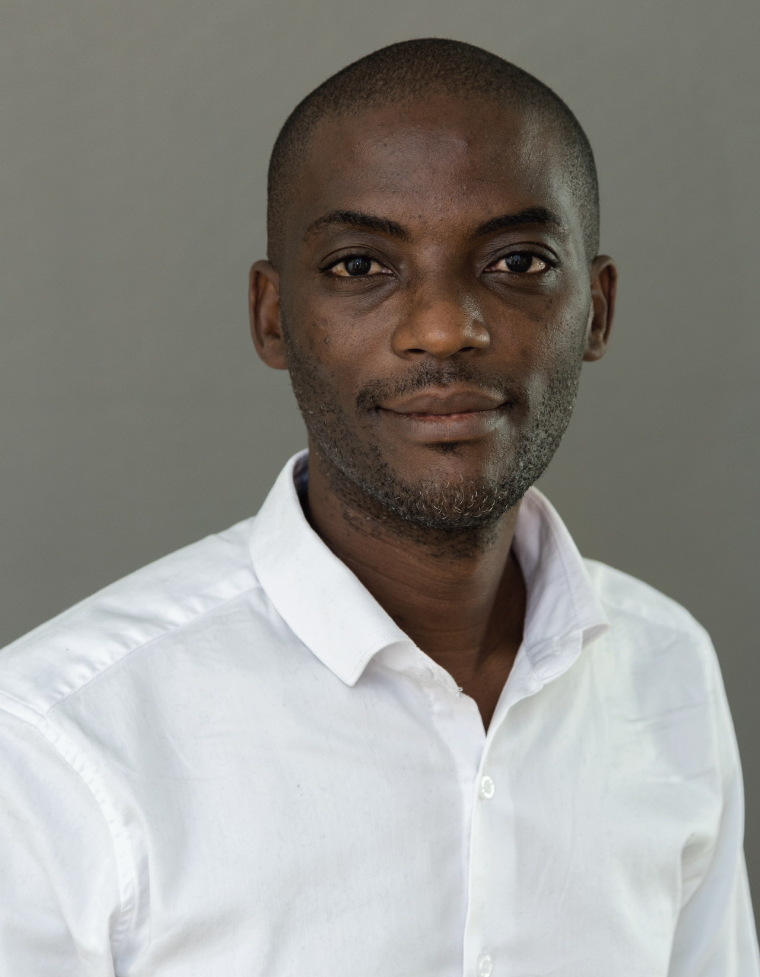
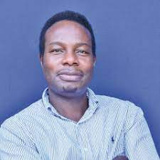
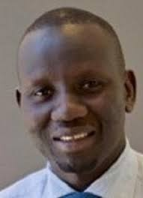

Concept of the Study
CHAKA study
368 cases vs 368 controls
Dr Dickens Akena
Dr. Kalungi Allan
Dr. Jjingo Daudi
Prof. E. Kinyanda
VULNERABILITY
Genetic
-SLC6A4
-TPH2
-FKBP5
-NR3C1
Biological
-Telomere length
-CD4 count
-HIV viral load
-WHO HIV clinical stage
Psychosocial
-Stress
-Social support
-Sociodemographic
PREDICTION: MACHINE LEARNING
Emotional disorders outcomes at 12 months
Source: Own source

Slide 3

Study Aims
Aim 1
Build a machine learning model for prediction of incident and persistent cases of emotional disorders
Aim 2
Evaluate performance of the model for each of genetic, biological and psychosocial factors respectively
Aim 3
Evaluate performance of the model which includes all the three factor domains of genetic, biological and psychosocial factors

Slide 4
Method
01
02
03
Data Cleaning & Feature engineering
Choose algorithm (DT, RF, LR, SVM)
Identify data
05
04
Model Deployment
Train, Validate & Test the model
Source: https://slidesgo.com/

Slide 5
Machine Learning Model Development
Prerequisite
Dataset, Python (v3.11.5) and packages (Pandas), ML framework (pycaret) etc.
Step 1: Data Splitting
Step 2: Model Building (Objective 1)
Supervised ML techniques
Decision trees, random forests, logistic regression, and support vector machines from Pycaret
Step 3: Model Evaluation (Objective 2)
The AUC was computed (also report (precision, recall, and F1 score).
Step 4: Model Integration (Objective 3)
A model using all the three predictors (genetic, biological, and psychosocial factors) will be constructed.

Slide 6
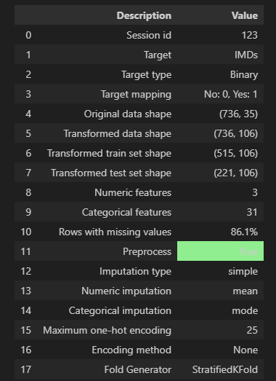
RESULTS/METHOD
Dropping Non-Important and Redundant Variables
# List of variables to drop
columns_to_drop = ['PatientID', 'age', 'height_m', 'BMI', 'rounded_bmi', 'motherali1', 'fatherali1', 'ses', 'cd4takeoff1', 'Viralload', 'ptsd', 'gad', 'mdd', 'pc', 'intdis', '_merge' ]

Slide 7
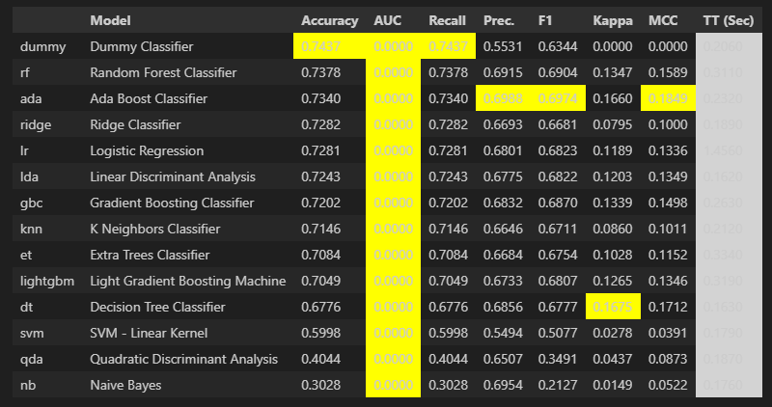
RESULTS/METHOD
For Psychosocial Data (Training)

Slide 8
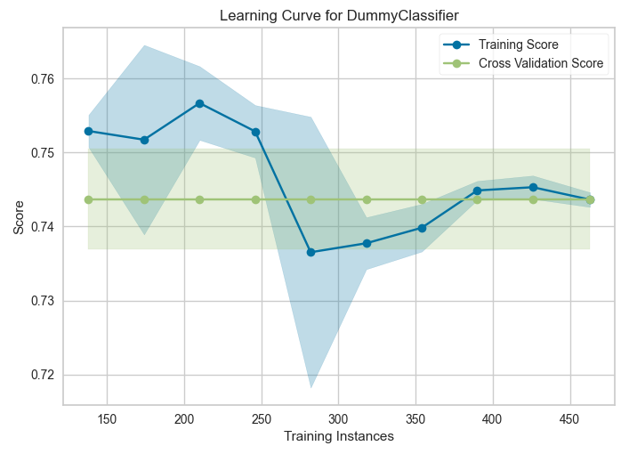
RESULTS/METHOD
For Psychosocial Data (Training Curve)

Slide 9
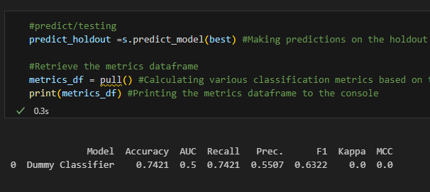
RESULTS/METHOD
FOR PSYCHOSOCIAL DATA (Testing/Performance)

Slide 10
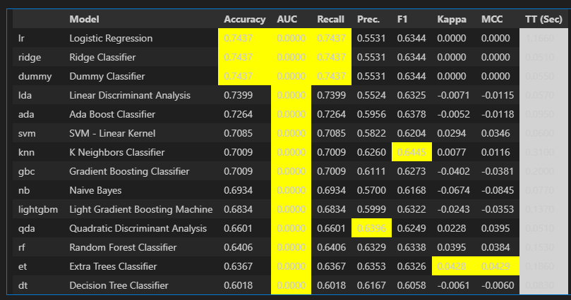
RESULTS/METHOD
For Biological Data (Training)

Slide 11
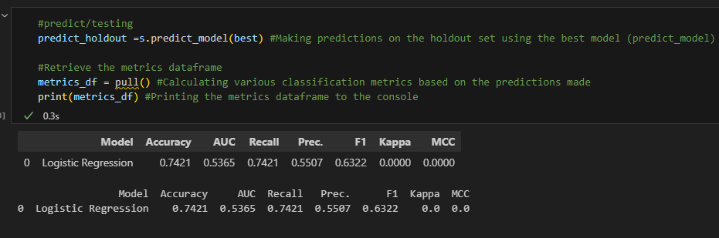
RESULTS/METHOD
For Biological Data (Test/Performance)

Slide 12
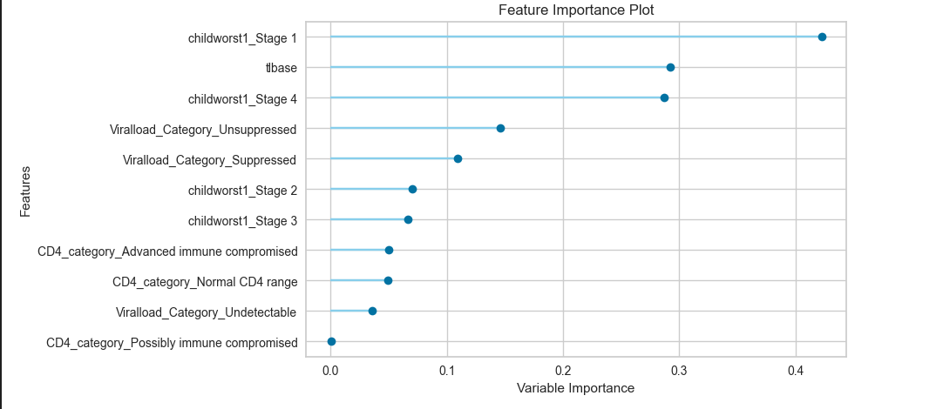
RESULTS/METHOD
For Biological Data (Plot)

Slide 13
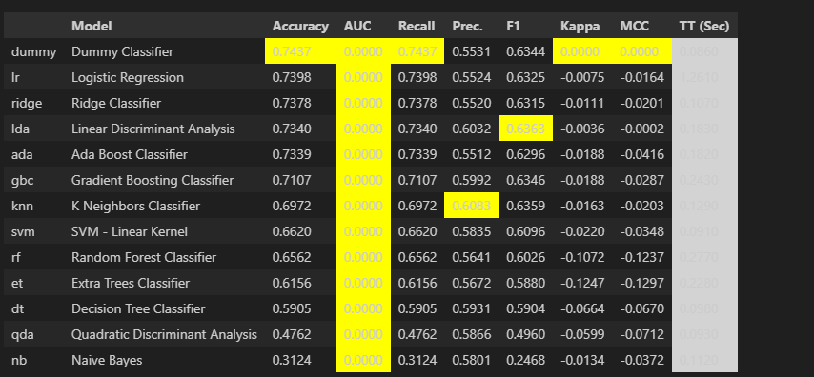
RESULTS/METHOD
For genetics data (Training)

Slide 14
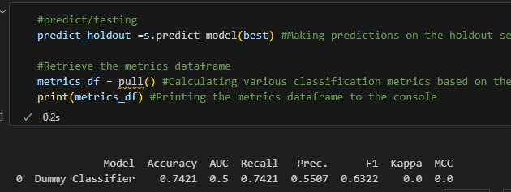
RESULTS/METHOD
For genetics data (Testing)

Slide 15
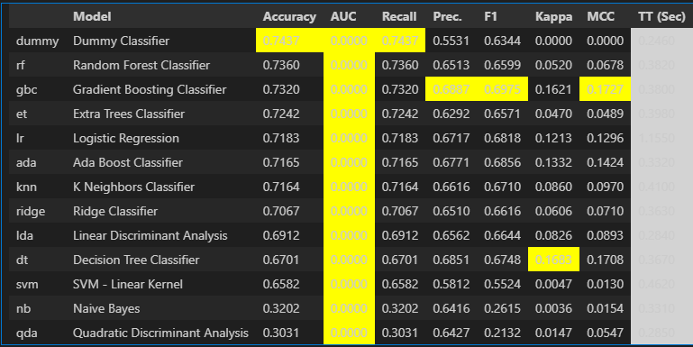
RESULTS/METHOD
All Three Categories (Training)

Slide 16
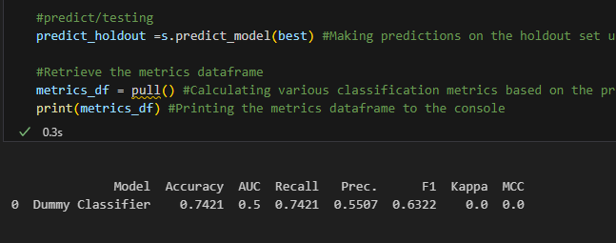
RESULTS/METHOD
ALL THREE CATEGORIES (Testing)

Slide 17
THE END

